Slide 1

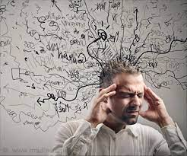

University of Basra
College of Nursing
Psychiatric Mental Health Nursing
Mood Disorders and Suicide

Slide 2
Everyone occasionally feels sad, low, and tired, with the desire to stay in bed and shut out the world. These episodes are often accompanied by anergia
(lack of energy), exhaustion, agitation, noise intolerance, and slow thinking processes, all of which make decisions difficult

Slide 3
Euthymic mood (average affect and activity).
Mood disorders, also called affective disorders, are pervasive alterations in emotions that are manifested by depression or mania or both.
Mood disorders are the most common psychiatric diagnoses associated with suicide; depression is one of the most important risk factors for it
Only 9% of people with mood disorders exhibit psychosis

Slide 4
CATEGORIES OF MOOD DISORDERS
The primary mood disorders are:
Major Depressive Disorder
Bipolar Disorder (Formerly Called Manic-depressive Illness).

Slide 5
RELATED DISORDERS
Persistent depressive (dysthymic) disorder is a chronic, persistent mood disturbance characterized by symptoms such as insomnia, loss of appetite, decreased energy, low self-esteem, difficulty concentrating, and feelings of sadness and hopelessness that are milder than those of depression.
Disruptive mood dysregulation disorder is a persistent angry or irritable mood, punctuated by severe, recurrent temper outbursts that are not in keeping with the provocation or situation, beginning before age 10.
Cyclothymic disorder is characterized by mild mood swings between hypomania and depression without loss of social or occupational functioning.

Slide 6
Substance-induced depressive or bipolar disorder is characterized by a significant disturbance in mood that is a direct physiological consequence of ingested substances such as alcohol, other drugs, or toxins.
Seasonal affective disorder (SAD) has two subtypes. In one, most commonly called winter depression or fall-onset SAD, people experience increased sleep, appetite, and carbohydrate cravings; weight gain; interpersonal conflict; irritability; and heaviness in the extremities beginning in late autumn and abating in spring and summer. The other subtype, called spring-onset SAD, is less common, with symptoms of insomnia, weight loss, and poor appetite lasting from late spring or early summer until early fall. SAD is often treated with light therapy
Postpartum or “maternity” blues is a mild, predictable mood disturbance occurring in the first several days after delivery of a baby. Symptoms include labile mood and affect, crying spells, sadness, insomnia, and anxiety.

Slide 8
Postpartum depression is the most common complication of pregnancy in developed countries .The symptoms are consistent with those of depression (described previously), with onset within 4 weeks of delivery.
Premenstrual dysphoric disorder is a severe form of premenstrual syndrome and is defined as recurrent, moderate psychological and physical symptoms that occur during the week before menses and resolving with menstruation. Approximately 20% to 30% of premenopausal women are affected by affective and/or somatic symptoms that can cause severe dysfunction in social or occupational functioning, such as labile mood, irritability, increased interpersonal conflict, difficulty concentrating, feeling overwhelmed or unable to cope, and feelings of anxiety, tension, or hopelessness.

Slide 9
• Postpartum psychosis is a severe and debilitating psychiatric illness, with acute onset in the days following childbirth. Symptoms begin with fatigue, sadness, emotional lability, poor memory, and confusion and progress to delusions, hallucination poor insight and judgment, and loss of contact with reality.
Nonsuicidal self-injury involves deliberate, intentional cutting, burning, scraping, hitting, or interference with wound healing. Some persons who engage in self-injury (sometimes called self-mutilation) report reasons of alleviation of negative emotions, self-punishment, seeking attention, or escaping a situation or responsibility.

Slide 10
ETIOLOGY
Various theories for the etiology of mood disorders exist. The most recent research focuses on chemical biologic imbalances as the cause
Biologic Theories
A. Genetic Factors
*First-degree relatives of people with bipolar disorder have a sevenfold risk for developing bipolar disorder compared with a 1% risk in the general population.
*For all mood disorders, monozygotic (identical) twins have a concordance rate (both twins having the disorder) two to four times higher than that of dizygotic (fraternal) twins.
*genetics alone do not account for all mood disorders
There are also indications of a genetic overlap between early-onset bipolar disorder and early-onset alcoholism

Slide 11
B. Neurochemical Theories
**Neurochemical influences of neurotransmitters (chemical messengers) focus on serotonin and norepinephrine as the two major biogenic amines implicated in mood disorders
**Serotonin has many roles in behavior
Deficits of serotonin, its precursor tryptophan, or a metabolite (5-hydroxyindole acetic acid) of serotonin found in the blood or cerebrospinal fluid occur in people with depression.
**Norepinephrine levels may be deficient in depression and increased in mania.
**Dysregulation of acetylcholine and dopamine is also being studied in relation to mood disorders.

Slide 12
C. Neuroendocrine Influences
Hormonal fluctuations are being studied in relation to depression. Mood disturbances have been documented in people with endocrine disorders, such as those of the thyroid, adrenal, parathyroid, and pituitary glands.
About 5% to 10% of people with depression have thyroid dysfunction, notably an elevated thyroid-stimulating hormone. This problem must be corrected with thyroid treatment, or treatment for the mood disorder is adversely affected

Slide 13
D. Psychodynamic Theories Theories
Many psychodynamic theories about the cause of mood disorders seemed to “blame the victim” and his or her family. They include the following beliefs or suppositions:
The self-depreciation of people with depression becomes self-reproach and “anger turned inward” related to either a real or perceived loss.
A person’s ego (or self) aspires to be ideal (i.e., good and loving, superior or strong), and that to be loved and worthy, must achieve these high standards
The state of depression is like a situation in which the ego is a powerless, helpless child who is victimized by the superego
Most psychoanalytical theories of mania view manic episodes as a “defense” against underlying depression
Depression is a reaction to a distressing life experience, such as an event with psychic causality
Children raised by rejecting or unloving parents are prone to feelings of insecurity and loneliness, making them susceptible to depression and helplessness
Depression is a result of specific cognitive distortions in susceptible people

Slide 14
First. MAJOR DEPRESSIVE DISORDER
Major depressive disorder typically involves 2 weeks or more of a sad mood or lack of interest in life activities, with at least four other symptoms od depression
Anhedonia
changes in weight
Change in sleep
Change in energy
Change in concentration
Change in decision-making
Change in self-esteem
Change in goals.

Slide 15
Epidmiology
Major depression is twice as common in women and has a one-and-a-half to three times greater incidence in first-degree relatives than in the general population.
Incidence of depression decreases with age in women and increases with age in men.
Single and divorced people have the highest incidence.
Depression in prepubertal boys and girls occurs at an equal rate

Slide 16
Onset and Clinical Course
An untreated episode of depression can last from a few weeks to months or even years, though most episodes clear in about 6 months
Some people have a single episode of depression, while 50% to 60% will have a recurrence of depression.
Approximately 20% will develop a chronic form of depression.
Depressive symptoms can vary from mild to severe.
The degree of depression is comparable with the person’s sense of helplessness and hopelessness.
Some people with severe depression (about 20%) have psychotic features

Slide 17
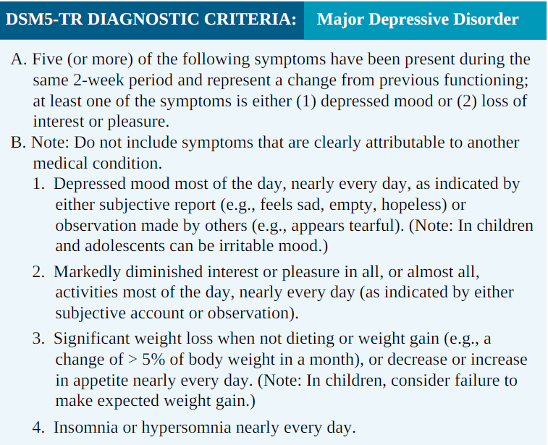

Slide 18
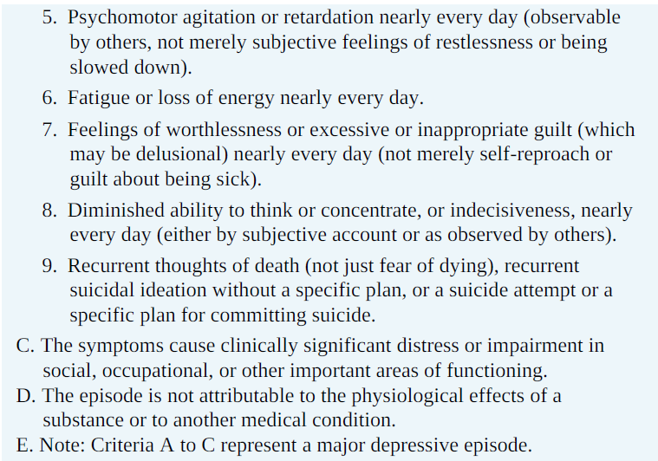

Slide 19
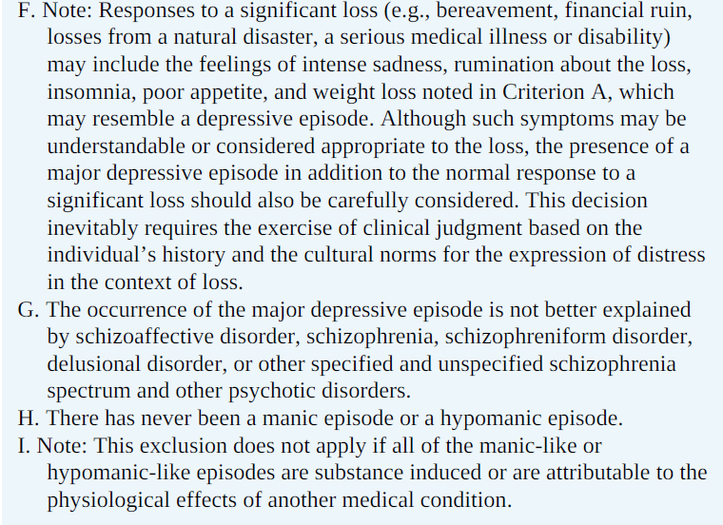

Slide 20
Treatment and Prognosis
A. Psychopharmacology
Major categories of antidepressants include
Cyclic antidepressants,
Monoamine oxidase inhibitors (maois),
Selective serotonin reuptakeinhibitors (ssris),
Atypical antidepressants.
The choice of which antidepressant to use is based on the (client’s symptoms, age, and physical health needs; drugs that have or have not worked in the past or that have worked for a blood relative with depression; and other medications that the client is taking)

Slide 21
Several antidepressants are used to treat depression. SSRIs have the fewest side effects.
Tricyclic antidepressants are older and have a longer lag period before reaching adequate serum levels; they are the least expensive type.
MAOIs are used least because clients are at risk for hypertensive crisis if they ingest tyramine-rich foods and fluids while taking these drugs. MAOIs also have a lag period before reaching adequate serum levels

Slide 22
Researchers believe that levels of neurotransmitters, especially norepinephrine and serotonin, are decreased in depression. Usually, presynaptic neurons release these neurotransmitters to allow them to enter synapses and link with postsynaptic receptors.
In clients who have acute depression with psychotic features, an antipsychotic is used in combination with an antidepressant. The antipsychotic treats the psychotic features; several weeks into treatment, the client is reassessed to determine whether the antipsychotic can be withdrawn and the antidepressant maintained.

Slide 23
Other Medical Treatments and Psychotherapy
Electroconvulsive Therapy. Psychiatrists may use electroconvulsive therapy (ECT)
1. treat depression in select groups, such as clients who do not respond to antidepressants
2. client who experience intolerable side effects at therapeutic doses (particularly true for older adults).
3. In addition, pregnant women can safely have ECT while many medications are not safe for use during pregnancy.
4. Clients who are actively suicidal may be given ECT if there is concern for their safety while waiting weeks for the full effects of antidepressant medication.
5. patients with psychotic features and marked psychomotor disturbances

Slide 24
Psychotherapy. A combination of psychotherapy and medications is considered the most effective treatment for depressive disorders in both children and adults .There is no one specific type of therapy that is better for the treatment of depression.
The goals of combined therapy are
1. symptom remission,
2. psychosocial restoration,
3. prevention of relapse or recurrence,
4. reduced secondary consequences such as marital discord or occupational difficulties,
5. increasing treatment compliance.

Slide 25
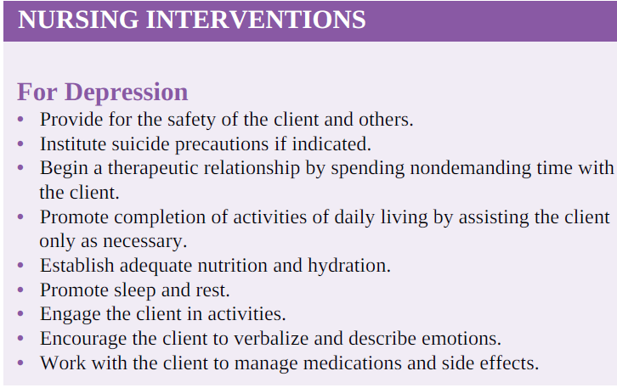

Slide 26
BIPOLAR DISORDER
Bipolar disorder involves extreme mood swings from episodes of mania to episodes of depression. (Bipolar disorder was formerly known as manicdepressive illness.)
During manic phases, clients are euphoric, grandiose, energetic, and sleepless. They have poor judgment and rapid thoughts, actions, and speech.
During depressed phases, mood, behavior, and thoughts are the same as in people diagnosed with major depression
if a person’s first episode of bipolar illness is a depressed phase, he or she might be diagnosed with major depression; a diagnosis of bipolar disorder may not be made until the person experiences a manic episode.

Slide 27
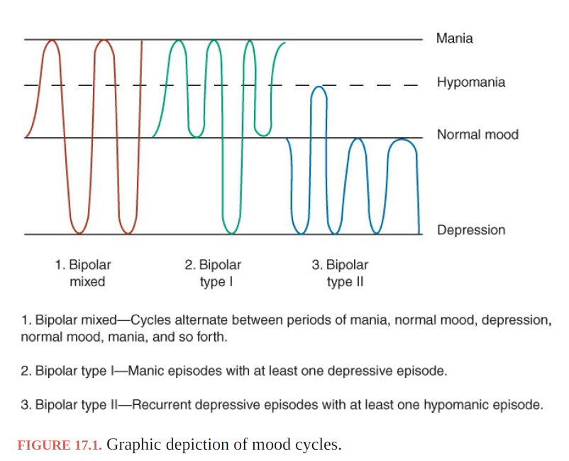

Slide 28
Onset and Clinical Course
The first manic episode generally occurs in a person’s teens, 20s, or 30s. Currently, debate exists about whether or not some children diagnosed with attention-deficit/hyperactivity disorder actually have a very early onset of bipolar disorder
Adolescents are more likely to have psychotic manifestations.
The diagnosis of a manic episode or mania requires at least 1 week of unusual and incessantly heightened, grandiose, or agitated mood in addition to three or more of the following symptoms: exaggerated self-esteem, sleeplessness, pressured speech, flight of ideas, reduced ability to filter extraneous stimuli, distractibility, increased activities with increased energy, and multiple, grandiose, high-risk activities involving poor judgment and severe consequences, such as spending sprees, sex with strangers, and impulsive investments

Slide 29
Treatment
Psychopharmacology
Treatment for bipolar disorder involves a lifetime regimen of medications— either an antimanic agent called lithium or anticonvulsant medications used as mood stabilizers.
Lithium. Lithium is a salt contained in the human body; it is similar to gold, copper, magnesium, manganese, and other trace elements. Once believed to be helpful for bipolar mania only, investigators quickly realized that lithium could also partially or completely mute the cycling toward bipolar depression.
Lithium’s action peaks in 30 minutes to 4 hours for regular forms and in 4 to 6 hours for the slow-release form. Onset of action is 5 to 14 days; with this lag period, antipsychotic or antidepressant agents are used carefully in combination with lithium to reduce symptoms in acutely manic or acutely depressed clients. The half-life of lithium is 20 to 27 hours

Slide 30
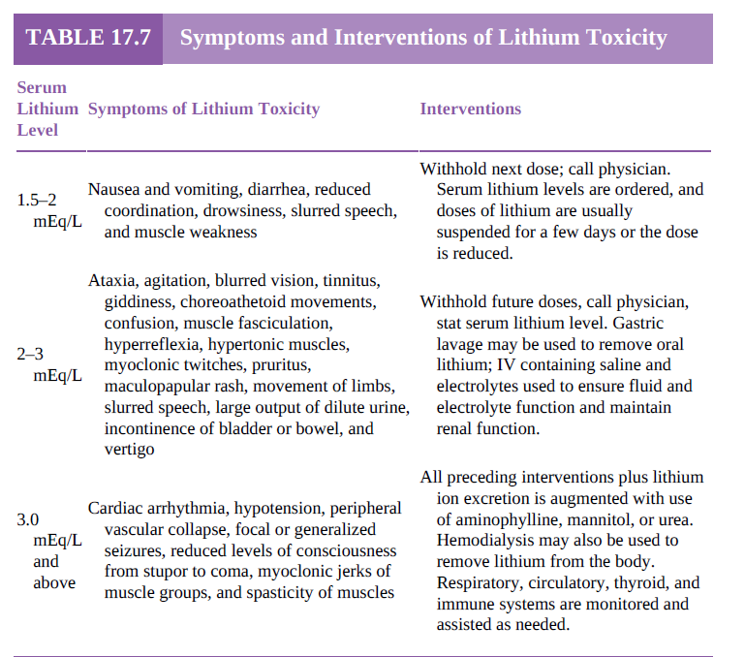

Slide 31
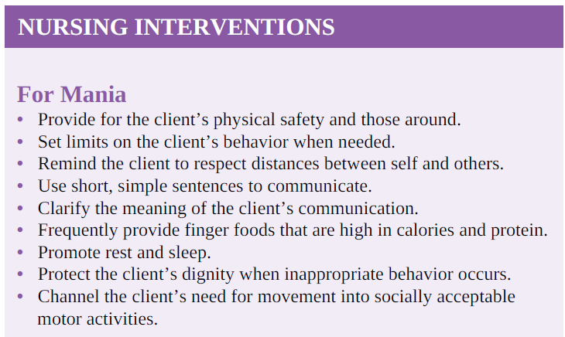

Slide 32
SUICIDE
Suicide is the intentional act of killing oneself. Suicidal thoughts are common in people with mood disorders, especially depression
Suicide attempts are estimated to be 8 to 10 times higher than completed suicides men commit. approximately 72% of suicides, which is roughly three times the rate of women, although women are four times more likely than men to attempt suicide. The higher suicide rates for men are partly the result of the method chosen (e.g., shooting, hanging, jumping from a high place). Women are more likely to overdose on medication. Men, young women, whites, and separated and divorced people are at increased risk for suicide. Adults older than 65 years compose 10% of the population but account for 25% of suicides.
Suicide is the second leading cause of death (after accidents) among people aged 15 to 24 years. The rate of suicide is increasing most rapidly among those ages 45 to 65 years

Slide 33
Clients with psychiatric disorders, especially depression, bipolar disorder, schizophrenia, substance abuse, posttraumatic stress disorder, and borderline personality disorder, are at increased risk for suicide. Chronic medical illnesses associated with increased risk for suicide include cancer, HIV or AIDS, diabetes, cerebrovascular accidents, and head and spinal cord injury
Environmental factors that increase suicide risk include isolation, recent loss, lack of social support, unemployment, critical life events, and family history of depression or suicide.
Behavioral factors that increase risk include impulsivity, erratic or unexplained changes from usual behavior, and unstable lifestyle

Slide 34
Suicidal ideation means thinking about killing oneself. Active suicidal ideation is when a person thinks about and seeks ways to commit suicide.
Passive suicidal ideation is when a person thinks about wanting to die or wishes he or she were dead but has no plans to cause his or her death.
People with active suicidal ideation are considered more potentially lethal.
Attempted suicide is a suicidal act that either failed or was incomplete. In an incomplete suicide attempt, the person did not finish the act because
(1) someone recognized the suicide attempt and responded or
(2) the person was discovered and rescued.
Suicide involves ambivalence
Most people with suicidal ideation send either direct or indirect signals to others about their intent to harm themselves.A few people who commit suicide give no warning signs. Some artfully hide their distress and suicide plans.
(Plans+ Means+ preparations for death+ Time and Place)

Slide 35
Conducting a suicide lethality assessment involves determining the degree to which the person has planned his or her death, including time, method, tools, place, person to find the body, reason, and funeral plans.
. Nursing interventions for a client at risk for suicide involve keeping the person safe by instituting a no-suicide contract, ensuring close supervision, and removing objects that the person could use to commit suicide.

Slide 36



